Slide 1

Assignment-3
Artificial
Intelligence
Shankheshkumar Ambaliya (CS22B005)
Aakarsh Bansal (CS22B001)
01

Slide 2
Breakdown of Heuristic Components
Component | Purpose
Material | Base scoring using standard piece values (Q=9, R=5, B=3.1, etc.)
Mobility | Rewards positions with more legal moves (i.e., more active pieces)
Center Control | Adds small bonuses for occupying central squares D4, D5, E4, E5
Terminal State | Checkmate = ±∞, Draw = 0 (ensures terminal positions are handled well)
02

Slide 3
Reasons Behind Evaluation Working well
Material advantage directly contributes to winning potential.
Mobility rewards flexibility and active piece development, discouraging cramped positions.
Center control reflects positional advantage, especially useful in early/mid-game.
Combined with Alpha-Beta Pruning, it allows deeper searches while still using the same heuristic.
Alpha-Beta Pruning improves Minimax by eliminating branches that cannot influence the final decision, resulting in faster decision-making without changing the outcome.
03

Slide 4
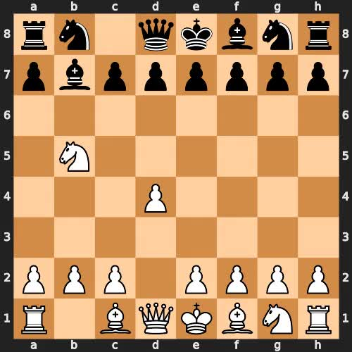
MiniMax
04

Slide 5
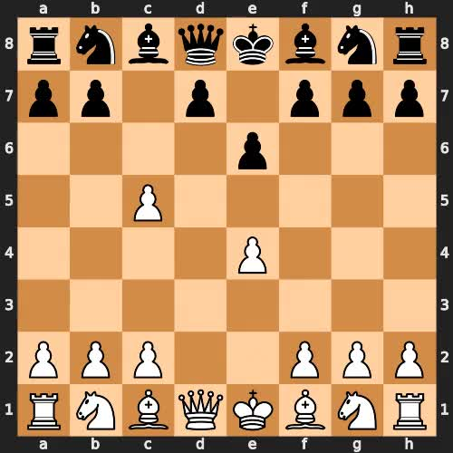
Alpha-Beta
Pruning
05

Slide 6
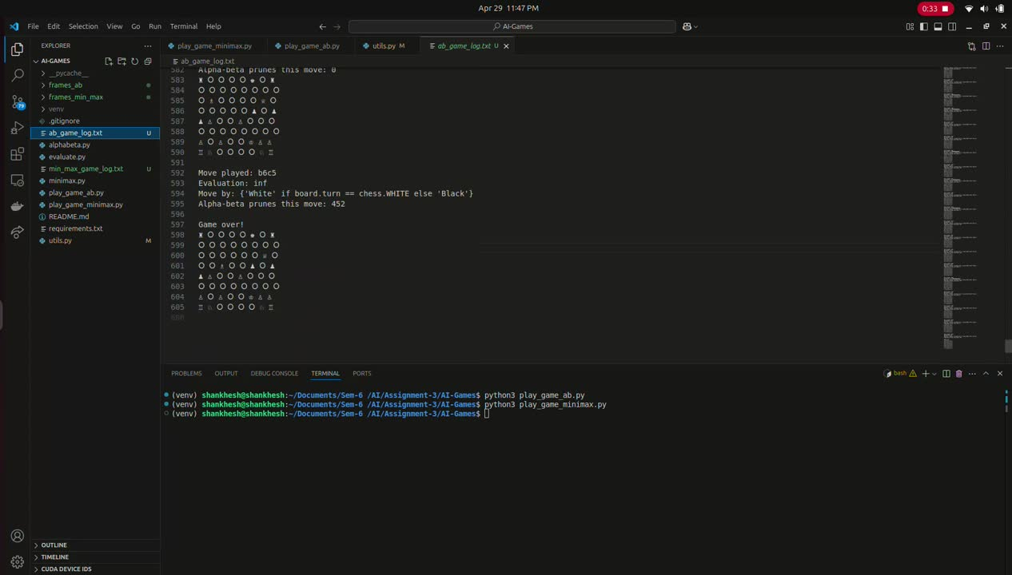
Running Code
06

